Slide 1



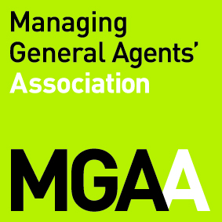
Brokers’ Exposure to Professional Negligence Claims arising from the Coronavirus Pandemic – How to Support your Broker Network.
Sam Moore, Robert Lloyd & Imran Benson
11 June 2020

Slide 2
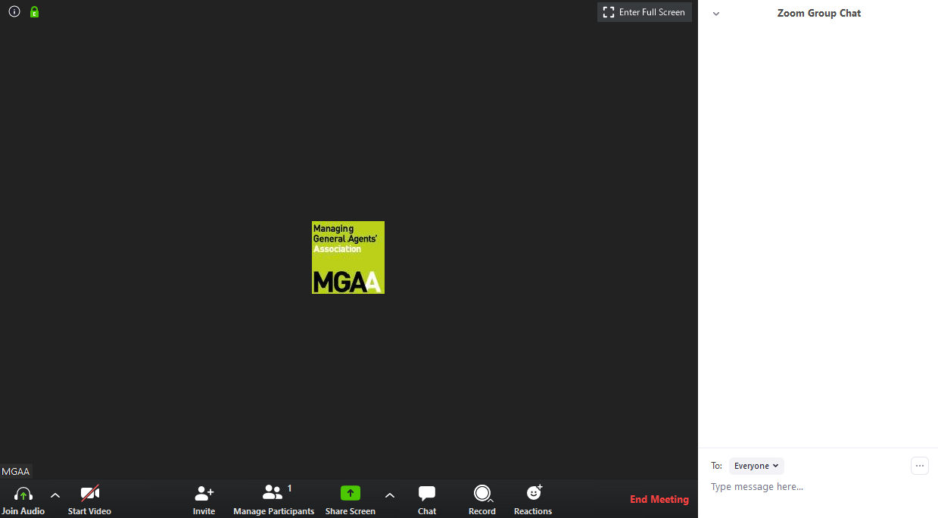

Brokers’ Exposure to Professional Negligence Claims arising from the Coronavirus Pandemic – How to Support your Broker Network
During the Webinar…
All participants are automatically muted
To ask a question…
The webinar is being recorded
Feedback forms
N

Slide 3
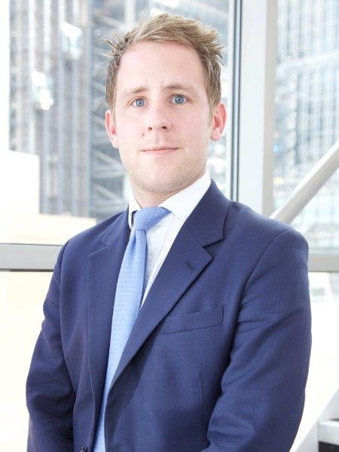


Brokers’ Exposure to Professional Negligence Claims arising from the Coronavirus Pandemic – How to Support your Broker Network
Today’s Speakers…
N
Sam Moore- Partner at Caytons
Robert Lloyd – Partner at Caytons
Imran Benson – Hailsham Chambers
Sam specialises in professional indemnity claims and policy coverage disputes. His practice is focused on a diverse range of professionals including architects, engineers, insurance brokers and solicitors as well as building contractors.
Robert has more than twenty-five years of experience as a solicitor with expertise in dispute resolution relating to insurance, construction, professional negligence, professional conduct, statutory liabilities, reinsurance, shipping and legal costs.
Imran regularly acts in insurance disputes concerning coverage and brokerage.
He has been involved in a number of fire/property damage claims, recovery claims and a full range of D&O disputes – especially involving fraud.

Slide 4
Brokers’ Exposure to Professional Negligence Claims arising from the Coronavirus Pandemic – How to Support your Broker Network.
Areas for Discussion
1 - The Current Context.
2 - The Extent of Policy Coverage for “Coronavirus Claims” – Business Interruption & Others.
3 - Brokers’ Obligations.
4 - Practical Steps that can be taken by MGAs to assist brokers comply with obligations.

Slide 5

Brokers’ Exposure to Professional Negligence Claims arising from the Coronavirus Pandemic – How to Support your Broker Network
The Impact of the Coronavirus Pandemic on the Insurance Industry
On 14 May 2020, Lloyds of London estimated:
The Lloyds market alone will pay out claims in the range of $3-4.3bn.
The insurance industry as a whole will suffer underwriting losses of about $107bn.
There will be a fall in the value of investment portfolios of an estimated $96bn.
The total loss to the insurance industry is estimated to be in the order of $203bn.
The anticipated losses are likely to exceed 9/11 and the combined impact of hurricanes Harvey, Irma and Maria in 2017.

Slide 6
Brokers’ Exposure to Professional Negligence Claims arising from the Coronavirus Pandemic – How to Support your Broker Network.
The FCA Warning
The Warning to Regulated Firms
On 19 March 2020, the FCA issued a warning to regulated firms:
“We expect firms to consider very carefully the needs of their customers and show flexibility in their treatment of them. We are likely to see customers’ behaviours change because of the pandemic. For example, this could mean that customers may need to work from home or commute by car. We would not expect to see their ability to claim impacted by circumstances over which they have little control.
We expect firms to clearly communicate any policy exclusions that may impact the cover and use of individual policies. This applies both to new sales or changes to existing policies (either mid-term or at renewal) – they must clearly meet consumers’ demands and needs.”
Guidance has been given in relation to various insurances including business interruption, travel, motor, home and private medical.
A Specific Warning to Brokers
Specifically in relation to brokers the FCA stated that:
“In these uncertain times, brokers have a key role to play to help consumers understand the market, the impact of coronavirus, and search the market for products that meet their demands and needs.
We encourage brokers to keep abreast of market developments so they can suitably advise their customers.”

Slide 7
Brokers’ Exposure to Professional Negligence Claims arising from the Coronavirus Pandemic – How to Support your Broker Network
Policyholder Expectations v Insurers’ Position
The Areas for Disputes Between Policyholders and Insurers
Probably one of the best illustrations of the tension is in respect of policyholder and insurers’ positions in relation to the “Notifiable Disease” add-ons to business interruption policies.
Area 1 – The Policy Wording
Action Groups: the policies respond to this situation. ABI: “Such add-on policies are not designed to cover a global, viral pandemic.”
Unfavourable headlines from insurers’ perspective such as “Insurers warned to stop ‘callous’ denial of claims” – The Times 9 May 2020.
Area 2 – The Extent to which Insurers should / can be flexible
Action groups are calling for insurers to: “consider payments on claims they might usually reject”
ABI have made points such as Insurers have obligations not to take steps that may endanger their solvency and that paying a significant volume of claims for which no premium was charged could endanger solvency and mean valid claims are not paid.
Area 3 – How Policies were Sold
Action groups say they purchased policies in the expectation there would be cover for this situation.
ABI – the polices were not priced to cover a global viral pandemic.
14 April 2020 – Insurance Times reported that Wimbledon has been paying about £1.5 million in premium per year since the SARs outbreak in 2003.
N

Slide 8

Brokers’ Exposure to Professional Negligence Claims arising from the Coronavirus Pandemic – How to Support your Broker Network
The FCA Test Case
On 1 May 2020, the FCA announced that it intends to obtain a court declaration to resolve “contractual uncertainty in business interruption (BI) insurance cover” in certain policies.
Some key points are that:
It is not intended to encompass all possible disputes but resolve some “key contractual uncertainties”.
It will be based on a sample of policies.
Trial expected around second half of July 2020.
It will not prevent individuals pursuing claims via courts or complaints by the Financial Ombudsman.

Slide 9

Brokers’ Exposure to Professional Negligence Claims arising from the Coronavirus Pandemic – How to Support your Broker Network
The Scope for Joint Litigations against both Insurers & Brokers
Dalamd Limited v Butterworth Spengler Commercial Limited [2018] EWHC 2558 (Comm) At paragraph 135 Mr Justice Butcher held:
“Given that the issue of whether or not the policy was voidable depends on the facts in existence at the time of the placement or renewal of the insurance this approach is consistent with the ordinary approach of the courts to determining matters of past fact. Furthermore, there appears to me to be good reason why, at least in the ordinary case, that should be the basis on which the issue is assessed. That reason is, in the cases of alleged brokers’ negligence, it is a common place that both the insurer and the broker are sued, very often in the same action. Manifestly, as against the insurer, the issue of whether policy is or is not voidable has to be determined on a yes/no basis…. In my judgment the issue should be determined against the broker on the same basis, and there should not be the possibility of a different basis depending on whether the insurer is and continues to be a party to the proceedings…..” (emphasis added)
In a number of cases (but not all) the courts will expect proceedings to be brought against both the Insurers and brokers at the same time in the event there is a dispute as to the extent of cover afforded under a policy.

Slide 10
Brokers’ Exposure to Professional Negligence Claims arising from the Coronavirus Pandemic – How to Support your Broker Network
To ask a question
All participants are automatically muted
To ask a question use the chat function
N

Slide 11
Are Insurers Liable?
Imran Benson

Slide 12
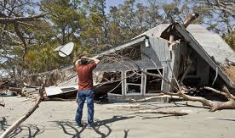
Typical Types of BI

Slide 13


Notifiable Disease & Denial of Access

Slide 14
Common Issues
What is interference/interruption: working from home?
Is Covid a relevant notifiable disease?
How is the 25 mile radius occurrence to be proven?
What, precisely, is required for denial of access?
Causation
Trends

Slide 15


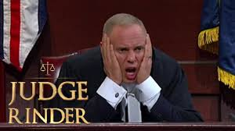
Answers?

Slide 16
Brokers’ Exposure to Professional Negligence Claims arising from the Coronavirus Pandemic – How to Support your Broker Network.
A Plague on Both Your Houses – Robert Lloyd
Brokers’ Obligations and Exposure to Claims for Non-Compliance with Policy Terms in the Time of Coronavirus
Or
Why Blame Me? I am fine. They are the sick ones.

Slide 17


Brokers’ Exposure to Professional Negligence Claims arising from the Coronavirus Pandemic – How to Support your Broker Network
We had fun we had joy we had seasons in the sun
Before the Insurance Act After the Insurance Act

Slide 18
Brokers’ Exposure to Professional Negligence Claims arising from the Coronavirus Pandemic – How to Support your Broker Network
The End of Innocence – “There were three of us in this marriage”
N
Simple: One Insurance Contract = Two Parties
Harder: + Intermediary = Three Parties
The kinds of 3rd wheel relationship might be as:
A contractor providing insurance related services,
An agent,
A professional adviser having expertise in insurance,
A regulated intermediary (under the Insurance: Conduct of Business sourcebook under the oversight of the FCA) and under the Code of Conduct of the Insurance Brokers Registration Council; and
As a data holder (GDPR) …so, it was a bit crowded”.

Slide 19
Brokers’ Exposure to Professional Negligence Claims arising from the Coronavirus Pandemic – How to Support your Broker Network
No one is Immune
N
Fail to make a fair presentation
Non-Compliance: Can still result in avoidance of the policy if it is deliberate or reckless, or in lesser cases result in rewriting terms of the policy (section 8 of the Insurance Act). This may effectively exclude a risk or a loss.
Fail to comply with a warranty
Non-Compliance: The Insurer can refuse indemnity for losses occurring or attributable to anything which happens while the Insured is in breach of warranty (see section 10 Insurance Act).
Fail to comply with conditions precedent to indemnity
Non-Compliance: The Insurer can “exclude or discharge” indemnity but only if the breach increased the risk (compliance reduces the risk) of loss as provided by sections 11 of Insurance Act.
Fail to comply with other terms and conditions
As for iii) but the consequences may not be so significant. Here the Insurer only aims to limit its liability and does not exclude or discharge it (see section 11 (2) Insurance Act).

Slide 20
Brokers’ Exposure to Professional Negligence Claims arising from the Coronavirus Pandemic – How to Support your Broker Network.
Shielding the Vulnerable – Those Brokers’ Duties in Full
Assessing the Insured’s needs
Not obtaining insurance
Not obtaining the insurance the Insured wanted
Not obtaining insurance meeting the Insured’s needs
Not exercising discretion in a reasonable way
Failing to act with reasonable speed
Liabilities associated with Non-Disclosure
Liabilities associated with Misrepresentation
Not advising adequately on the existence of and terms of cover
Other failure to give competent advice
Liabilities during the currency of the policy
Failure in respect of Notification and in respect of claims.
Note: Based on Jackson & Powell Chapter 10.

Slide 21
Brokers’ Exposure to Professional Negligence Claims arising from the Coronavirus Pandemic – How to Support your Broker Network.
The Sickness Spreads
Exposure is more than breach of duty, at least in tort
Classically liability depends on:
Breach of Duty
Assessed against an appropriate standard of care
Causation
Recoverable Loss.
Causation and Loss turns the issue back to the general insurance law and the indemnity available under actual Policies.
It is difficult to keep the focus on the Broker when the Insurers’ decisions are significant and questionable too.
See – Dalamd Limited v Butterworth Spengler Commercial Limited [2018] EWHC 2558 (Comm) – a pre-Insurance Act case

Slide 22
Brokers’ Exposure to Professional Negligence Claims arising from the Coronavirus Pandemic – How to Support your Broker Network
Not Business as Usual
Changing circumstances of the Insured and unusual working arrangements.
Potential difficulties in complying with warranties and conditions.
Cashflow difficulties may cause premium payments to be missed.
Change of normal methods of communication.
Insurers increasing premiums and restricting availability of insurance.
Insurers changing terms on offer: (even a temporary relaxation provides a burden when prior conditions are re-established); new exclusions/endorsements.
Insurers taking points they would not normally take.

Slide 23
Brokers’ Exposure to Professional Negligence Claims arising from the Coronavirus Pandemic – How to Support your Broker Network
Practical Steps that MGA’s can take to assist Brokers comply with obligations
Key Themes:
Clear / Timely Communication
Flexibility (where appropriate)
Understanding the needs of customers

Slide 24
Brokers’ Exposure to Professional Negligence Claims arising from the Coronavirus Pandemic – How to Support your Broker Network
Situation 1 – Markets Hardening – Lack of Capacity
The Brokers’ Obligation: Acting with reasonable speed
Keeping abreast of market developments.
Effecting insurance which meets clients needs.
Key Theme to Assist Compliance: Clear / timely communication.
Practical Steps: If certain policies are not going to be renewed / certain types of risks not going to be insured generally, then give early notice to your broker network as this allows time for cover to be arranged via alternative insurers.

Slide 25

Brokers’ Exposure to Professional Negligence Claims arising from the Coronavirus Pandemic – How to Support your Broker Network
Situation 2 – Restricted Cover / “Coronavirus Exclusions”
The Brokers’ Obligation: Advise on key policy terms.
Keep up to date with market developments.
Key Theme to Assist Compliance: Clear / timely Communication of new exclusions.
Practical Steps:
Standardised communication explaining the terms of a new exclusion that will be applied to policies going forward. This can be given to the client by the broker.

Slide 26
Brokers’ Exposure to Professional Negligence Claims arising from the Coronavirus Pandemic – How to Support your Broker Network
Situation 3 – The Scope for Flexibility
Standard policy wordings not corresponding to new circumstances caused by the pandemic.
Example: Property policy may contain a condition that it is not to be left unoccupied for a specified period, but compliance rendered impractical by lockdown.
The Brokers’ Obligation: Ensuring that client requirements are met.
Key Theme to Assist Compliance: Flexibility / understanding the needs of customers
Practical Steps: A flexible response to claims having regard to individual circumstances.

Slide 27
Further Information
This presentation should not be treated as specific advice in relation to a particular matter as other considerations may apply. Therefore, no liability is accepted for reliance on this presentation.
If specific advice is required, please contact one of the Partners at Caytons who will be happy to help.
caytonslaw.com
hailshamchambers.com
Sam Moore
Partner
Direct: +44 (0)20 7398 7623
moore@caytonslaw.com
Robert Lloyd
Partner, Caytons
Direct: +44 (0)20 7398 7623
lloyd@caytonslaw.com
Imran Benson
Barrister, Hailsham Chambers
Direct: +44 (0)20 643 5000
Imran.Benson@hailshamchambers.com
Sam Moore
1st June 2020

